Slide 1
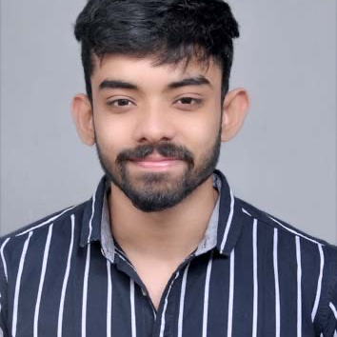

Aditya Chandrashekar Yadav
Bachelor of Engineering
Civil Engineering: 2018 - 2022
Skills
Java 8 /J2EE | Java Basics, OOPS, Generics, Collections, Arrays, Loops, Junit, Mockito.
Spring core | Autowiring, IOC & Dependency Injection.
Spring REST | REST controllers, Implementation of GET, POST, PUT & DELETE, Bean Validation & Exception Handling, Testing Services, Controller
AWS | Certified AWS CCP
Spring Cloud | Eureka Server for holding the information about all client-service applications.
Angular | Components, Services, Modules, Routing, Forms & Validation,
Database | Hands on practice with MongoDB, MySql.
UI Tech | HTML 5 & CSS 3,JavaScript, ES6 & TypeScript and bootstrap.
Tools | Git, Postman, Maven, IDE
Add On skills | Communications, Team management. Peer learning
-
Mumbai
aditya.chandrashekar-yadav@capgemini.com
+91 8446200282
A-4
Full Stack Developer
Hands on experience in creating microservices with Springboot, Spring Security, Spring Cloud API Gateway, Eureka server, API gateway.
Proficient in creating Single page Web Application in Angular with Authentication with Angular reactive forms, angular routing.
Java Microservice Development knowledge using Spring boot on a beginner-to-intermediate level.
Experience in swagger and in unit testing using Junit, Mockito.
REST Controllers, implementation of CRUD operations and exception handling.
Flight Management System
Completed end to end case study of Flight Management System and created four microservices.
Along with JWT authentication, Swagger and payment tab, responsive UI with Angular used for user interface.
Microservices were connected with API gateway.
Best practices like naming components, adding comments etc were followed throughout the project.
Within organization:
Experience in building UI with Smart UI Builder in Millenial Garage Team.
AWS CCP Certified.
Agile Software Development certified.
Check out my work on GitHub:
https://github.com/aditya5700
https://drive.google.com/drive/u/0/my-drive

